Slide 1
(on Dev) Probability – Bayes Theorem

Slide 2
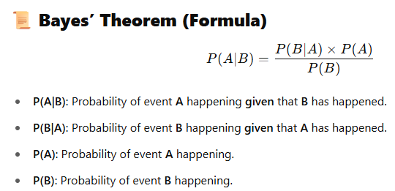
(OPTIONAL) Bayes theorem (p1)

Slide 3
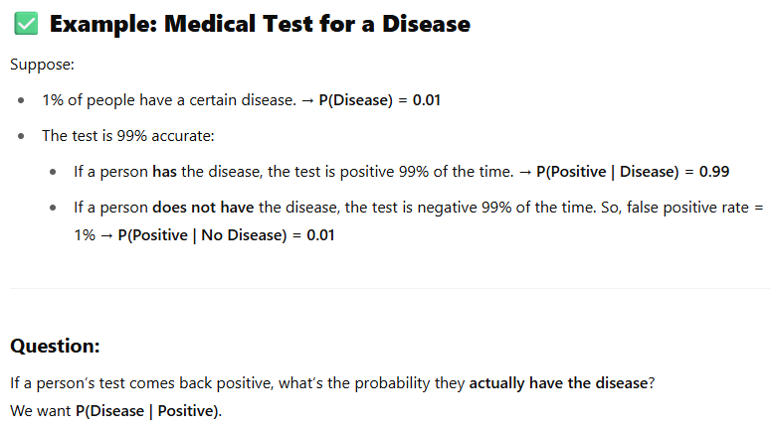
(OPTIONAL) Bayes theorem (p1)

Slide 4
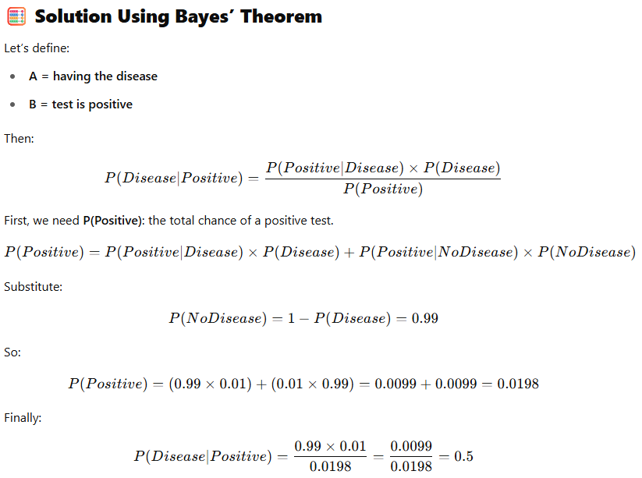
(OPTIONAL) Bayes theorem (p2)
Interpretation
Even with a positive test, the chance of actually having the disease is only 50% — because the disease is rare, and false positives matter!
Key Insight
Bayes’ Theorem helps us update our belief (from 1% chance to 50% chance) based on new evidence (the test result).

Slide 5
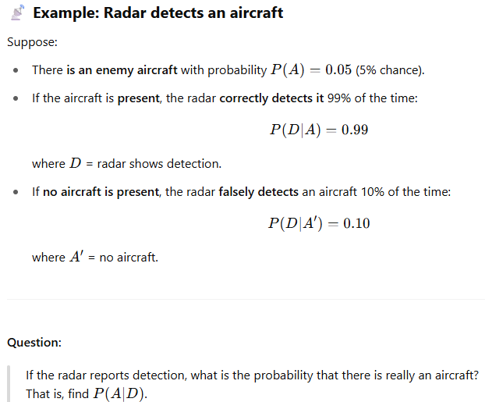
(OPTIONAL) Bayes theorem (p3)

Slide 6
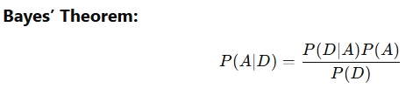
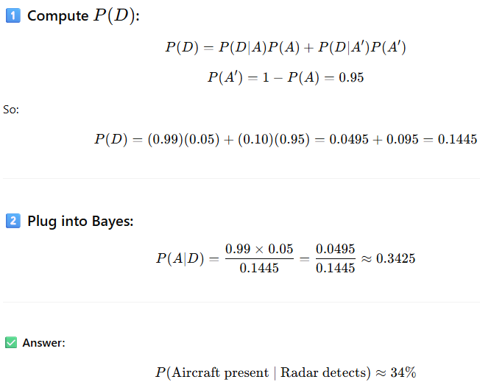
(OPTIONAL) Bayes theorem (p3)
Here we will use

